Slide 1
WELCOME

Slide 2
Music Genre Classification System
Guided by:-
Prof Mr. P. M. Gavali

Slide 3
Group members:
Sonali S. Kadolkar 17UCS51017XX
Shrutika B. Patil 17UIT11045CS
Priyanka M. Girmal 18UCS71002XX
Abhishek P. Pandharpatte 18UCS72009XX
Priya B. Sawant 18UCS71011XX

Slide 4
INDEX
1.Introduction
2.Problem Statement
3.What is Genre?
4.Literature Survey
5.Objective
6.System design
7.Expected Input And Output
8. Testing and Integration
9.Application
10.Conclusion
11.Reference

Slide 5
Introduction
With the growth of online music databases easy access to music content, people find it increasing hard to manage the songs they listen to. One way to categorize and organize songs is based on the genre.
Genre classification is an important task with many real word application.
In the past few years, with the prevalence of personal multimedia devices, a large amount of music is increasingly available on various application platforms.
However even with current musical genres , it is clear that the members of particular genre share certain characteristics typically related to the instrumentation, rhythmic structure, and pitch content of the music.

Slide 6
Problem Statement
Currently songs are classified manually according to it’s genre so the propose system is going to build a model for classifying the music in current genre.

Slide 7
What is Genre?
A way of describing what an item shares with other items as well as what differentiates it from other items .
A music genre is a conventional category that identifies some pieces of music as belonging to a shared tradition or set of conventions , it is to be distinguished from musical form and musical style, although in practice terms are sometime used interchangeably.

Slide 8
Literature Survey
There are different number of approaches to develop the system for classification of Music based on the genre.
The ground-breaking work, based on Naive Bayesian and Neural Network approaches, identifies one out of four styles of a musician improvisation. They were testing a performer’s ability to consistently produce intentional and different styles.
Another classic work in the area includes formation of three different feature sets to represent timbral texture, rhythmic and pitch content.
Short-time Fourier Transform (STFT), Mel-frequency Cepstral Coefficients (MFCCs), Wavelet Transform (WT), and some additional parameters were used to obtain feature vectors.

Slide 9
Objective
To build a model that classifies Music into its respective genre.
To analyze accuracy of model and classifying the music into respective genre.

Slide 10
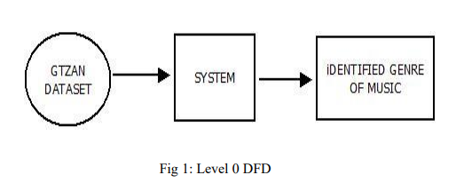
System Design
DFD-0 Diagram:-

Slide 11
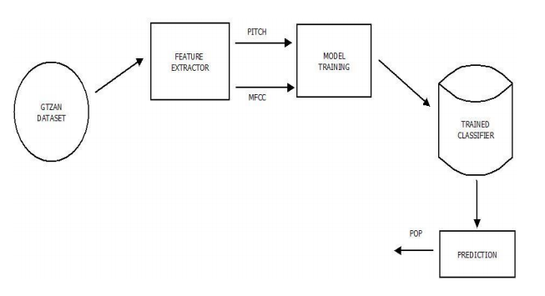
DFD-1Diagram

Slide 12
Software requirement
Operating system – Windows 8 or higher.
Python installed on machine or Anaconda Distribution of Python 3

Slide 13
Hardware requirement
Personal computer with standard configuration.
RAM – Minimum 4 GB.
Processor – Intel Core i3 or higher.

Slide 14
Methodology
1) Input the audio files from the dataset.
2) Preprocess the data.
3) Perform the feature extraction on the audio file (features like MFCC).
4) Train the model with the available dataset.
5) Test the model against new data.
6) Is testing successful?
a) Yes: Classifier is ready to use in an application.
b)No: Go to step 4 again.
7) Stop

Slide 15
Expected Input And Output
Input:
An audio file will be given to the model.
Output:
The model will classify the given audio file into its respective genre.

Slide 16
Testing and Integration

Slide 17
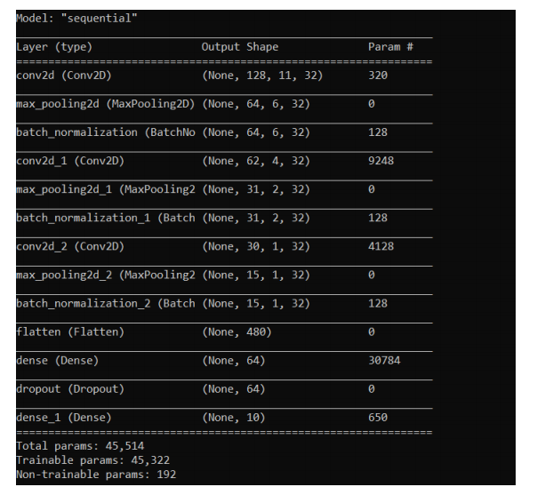

Slide 18
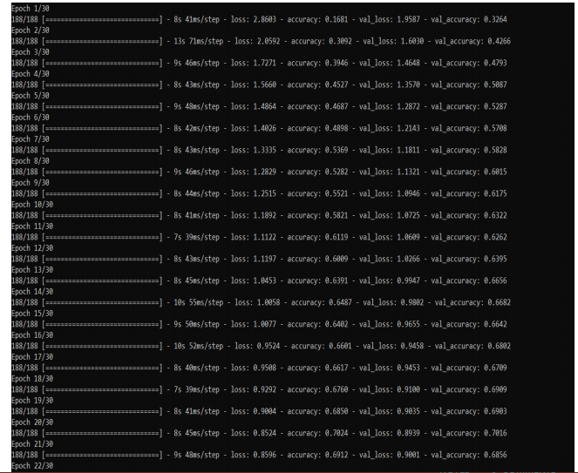

Slide 19
Application
The Music genre classifier can be used for different purposes.
Using the developed model we can build the music recommendation system.
This model can also be used to develop the Online Music Streaming Applications.

Slide 20
Conclusion
In this project we studied several methods of music genre classification. We study several audio feature extraction methods using digital signal processing methods, including MFCC (mel-frequency cepstral coefficients), ZCR (zero-crossing rate), etc.
One is the combination with different level features with decision tree or random forest model, and the other one is the combination with a series of MFCC coefficients with KNN and K-Means clustering.

Slide 21
REFERENCES
https://www.sciencedirect.com/science/article/pii/S1110866512000151#:~:text=Tests%20were%20carried%20out%20with,set%20of%20parameters%20for%20each
https://www.irjet.net/archives/V6/i5/IRJET-V6I5174.pdf
https://cse.iitk.ac.in/users/cs365/2015/_submissions/archit/report.pdf
https://ieeexplore.ieee.org/document/8441340

Slide 22
THANK YOU!

